Slide 1
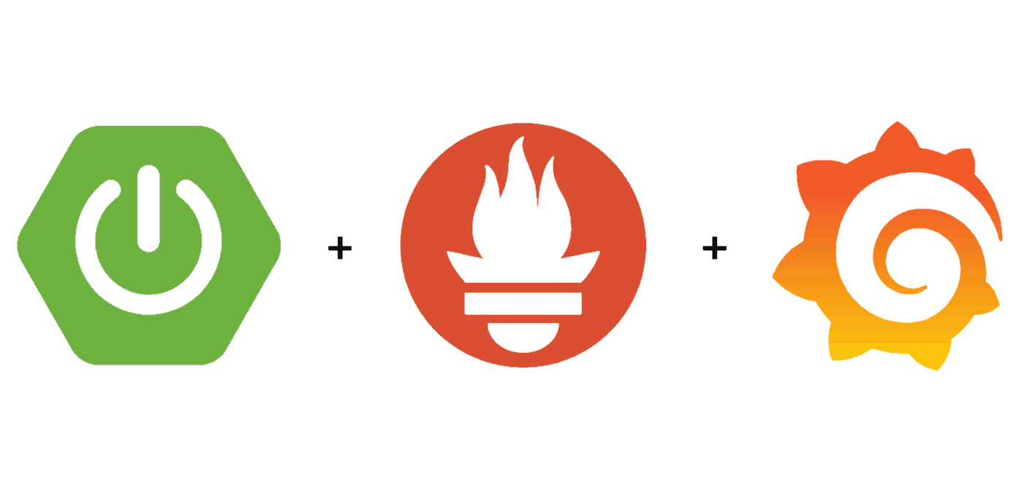
Using Prometheus with Grafana to monitor Kubernetes Clusters

Slide 2
Monitoring your infrastructure why ?
Collection of regular data on your IT infrastructure.
Alerts your IT management company or staff to unplanned downtime, network intrusion, and resource saturation.
Saves you money as it minimises the network downtime and enhances efficiency.

Slide 3

What is Prometheus? (forethought)
Prometheus is an open-source system for event monitoring and alerting.
It records real-time metrics in a time series database.
Its built using a HTTP pull model to scrape endpoints.
Uses flexible queries and real-time alerting.

Slide 4




Prometheus-Operator
Prometheus Operator creates/configures/manages Prometheus clusters on top of Kubernetes
node-exporter
mongodb-exporter
https://github.com/percona/mongodb_exporter https://github.com/coreos/prometheus-operator https://sysdig.com/blog/kubernetes-monitoring-prometheus/

Slide 5
More about prometheus
There are a number of libraries and servers which help in exporting existing metrics from third-party systems as Prometheus metrics. https://prometheus.io/docs/instrumenting/exporters/
Metrics and labels https://prometheus.io/docs/practices/naming/

Slide 6
References
Time- series database blog https://blog.timescale.com/blog/what-the-heck-is-time-series-data-and-why-do-i-need-a-time-series-database-dcf3b1b18563/ Node-exporter helm chart https://github.com/helm/charts/tree/master/stable/prometheus-node-exporter
MongoDB-exporter helm chart
https://github.com/helm/charts/tree/master/stable/prometheus-mongodb-exporter
Prometheus-operator helm chart
https://github.com/helm/charts/tree/master/stable/prometheus-operator
Trying Prometheus Operator with Helm + Minikube
https://medium.com/faun/trying-prometheus-operator-with-helm-minikube-b617a2dccfa3
Percona Monitoring and Management (PMM) Graphs https://www.percona.com/blog/2017/03/10/percona-monitoring-and-management-pmm-graphs-explained-custom-mongodb-graphs-metrics/
Mongodb monitoring - https://docs.mongodb.com/manual/administration/monitoring/

